Slide 1
Excellence in doctoral training
Dr Rob Hardwick, BBSRC
Senior Innovation & Skills Manager

Slide 2
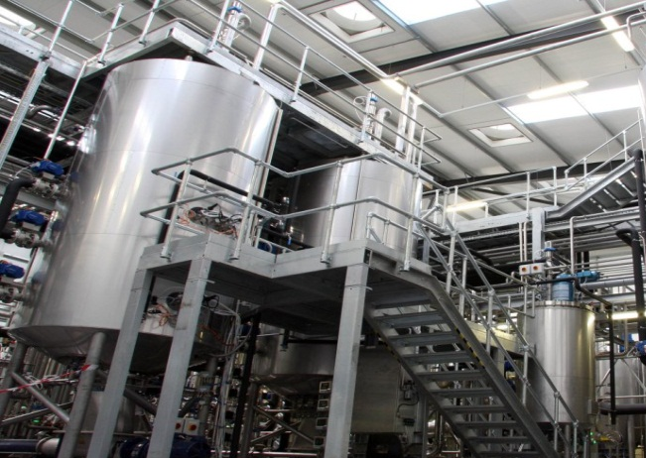
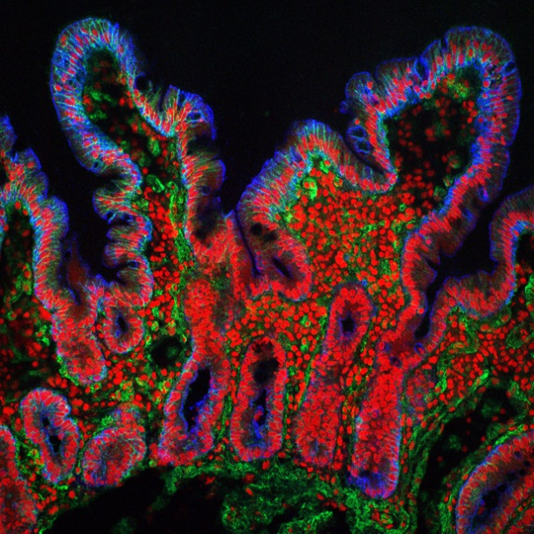
What does BBSRC do?
Fund world-class bioscience research in UK Universities and Institutes
Fund bioscience training and skills for the next generation of bioscientists
Drive the widest possible social and economic impact from our bioscience in industry, policy and public goods
Promote public dialogue on bioscience
Agriculture and food security
Industrial biotechnology and bioenergy
Bioscience for health

Slide 3
Excellence in Doctoral Training
Working in partnership, BBSRC will deliver world-class doctoral training
High-quality project – Challenging, feasible and realistically achievable; generates excellent research in BBSRC priority areas
High-quality training environment – Stimulating environments for research / professional cohort-based training, under excellent supervision
High-quality student experience – An enriched training experience, allowing students to acquire novel skills, expertise and an understanding of the impact of their research, to enhance their career prospects
Notes:
All BBSRC PhD students will have the opportunity for non-academic research experience, through a professional internship or CASE placement

Slide 4
Research Skills
Original research project
Application of advanced research methods
Core Bioscience Skills
Bioinformatics – coding and data visualisation
Mathematical modelling
Professional Skills
Commercial awareness, business skills and entrepreneurship
Defending a thesis in a viva
Statistical analysis
Communication skills
Ethical awareness and public engagement
Professional Internship (PIPS)
Experimental design and hypothesis testing
Interdisciplinary working
Image credits 1.Thinkstock 2.EMBL EBI 3.Thinkstock

Slide 5
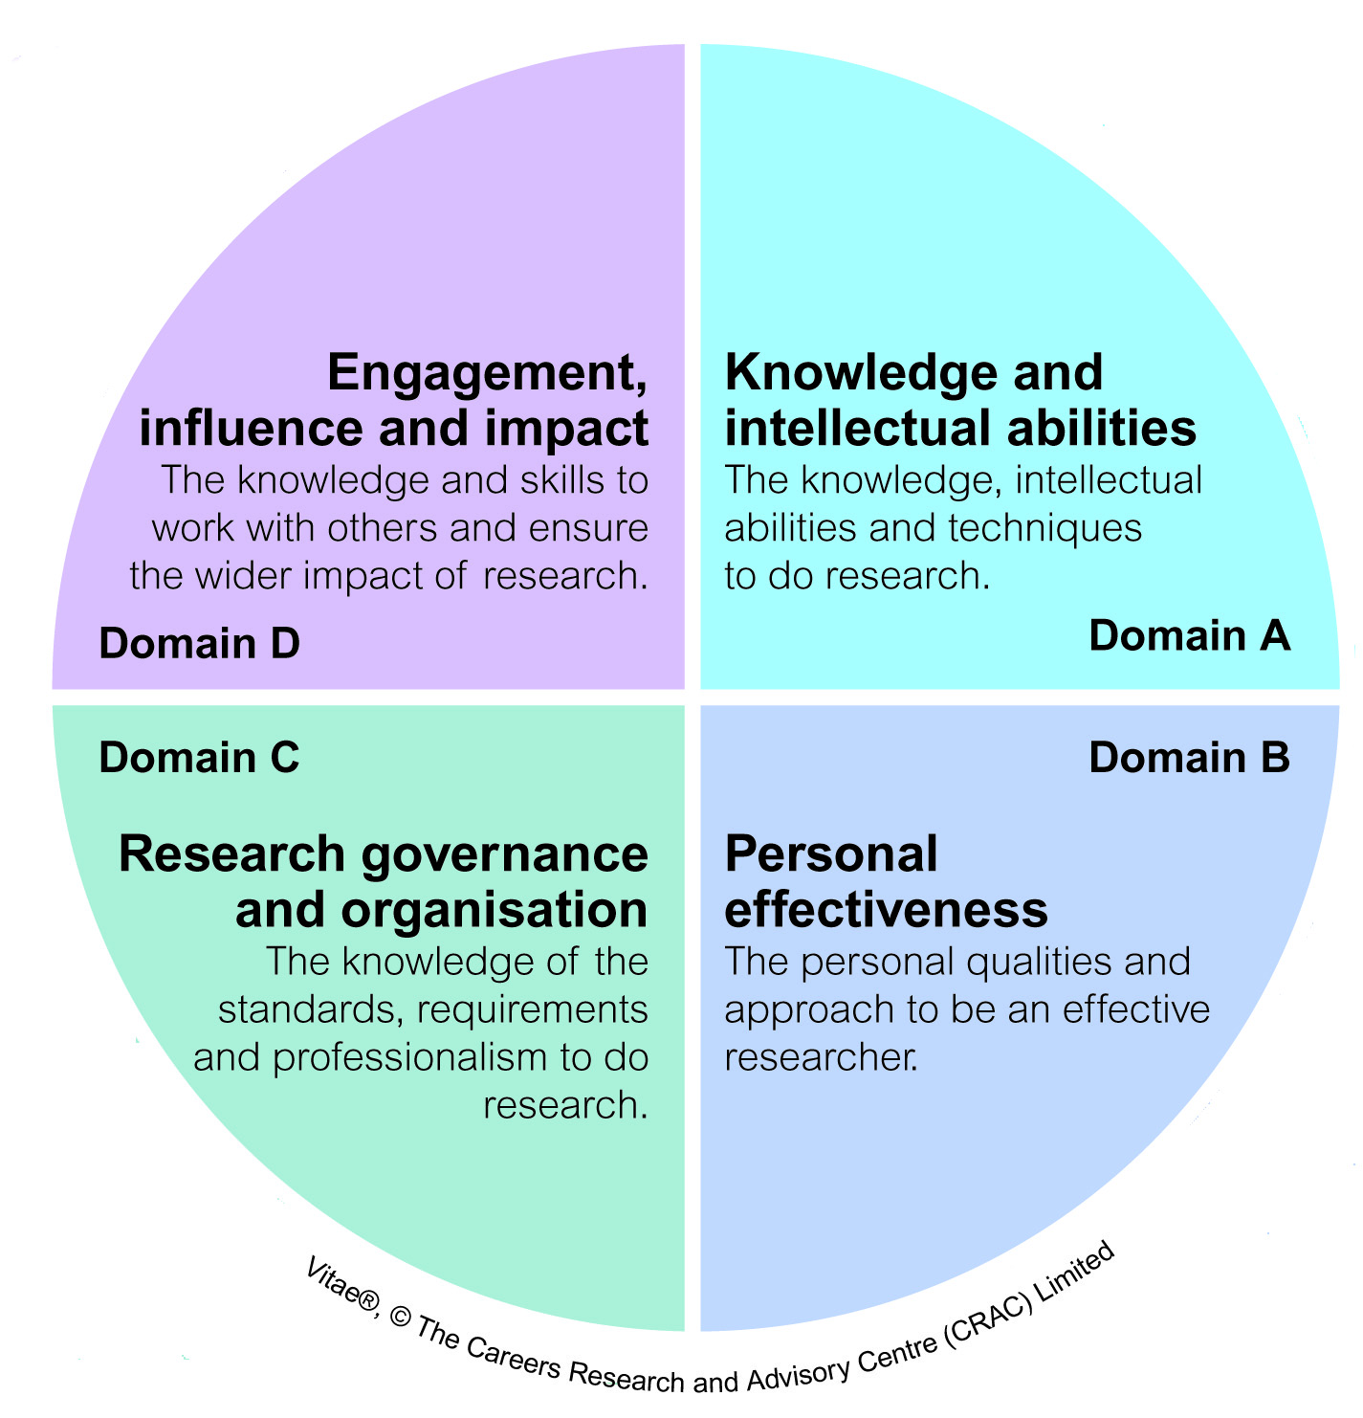
Structured, cohort-based training
Developing a breadth and depth of skills and competencies; not just specialised knowledge
Personal and professional competencies delivered through structured doctoral training
Personalised in line with an individual’s qualifications and experience
RDF as a tool for training needs analysis
Cohort-based to promote peer-to-peer support, idea sharing and collaboration
Researcher Development
Framework
Notes:
The skills, competencies and abilities that a PhD graduate ought to possess in order to meet the demands from potential employers today could include (but are not limited to):
• managerial and leadership skills;
• the ability to communicate with the public;
• the ability to connect with foreign colleagues in networks;
• administration of projects;
• dealing with and understanding political circumstances;
• negotiating with business partners;
• cultural understanding

Slide 6
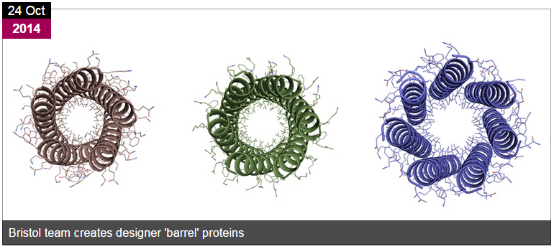
Specialist and core research skills
Case Study
Proteins seem to use a limited number of natural structural types
A team from Bristol (including DTP student, Chris Wood) showed it is possible to design more protein structures
On his core DTP training…
“the two week stats course was by far the most useful.
I use elements of this pretty frequently, some of which
helped with preparing figures for this paper.”
Thomson, A.R. et al. ‘’Computational design of water-soluble α-helical barrels.’ Science. 2014 Oct 24;346(6208):485-8.
Notes:
New tools and technologies, advances in computation and multidisciplinary approaches are changing the way in which bioscience is undertaken.

Slide 7
“I have contributed to work both for a patent application and publication. I also intend to work for the company after I finish my PhD.”
Work experience is becoming increasingly important as part of undergraduate and postgraduate curricula
PIPS is an opportunity to carry out a three-month, three month placement not directly related to the PhD project
Not intended to replace other professional skills training – it complements this with experiential learning
“The biggest achievement for me was the offer for me to go back after my PhD for a job.”
“I am involved in IP training for new academic staff and research personnel. There is potential for consultancy work”

Slide 8
You can do almost anything with PIPS!
“My PIPS placement was not just purely about the job role. It was also about living in a different country which brings with it a very different culture and challenges”
Working in a brewery Planning, costing, and marketing wine and beer tasting events
Working abroad
Iguana conservation in Honduras; Chimpanzee sanctuary in Zambia
“I was extremely pleased to gain an approximately WSET level 2 understanding of wines and spirits. This is a sufficient level of knowledge to be able to move towards a position within the wine and spirits industry.”
Working in a cake shop Customer service, packaging and pricing, photography for marketing

Slide 9
More students, more opportunities
Increasing numbers of postgraduates in Biological, Veterinary and Agricultural Sciences
Destinations of BBSRC-funded PhD students (graduating between 31 July 2010 and 1 August 2011)
In a highly competitive, rapidly changing and globalised research environment, there are increasing student numbers but also increasing opportunities
Notes:
Now more cohort-based with increasing focus on transferable skills training to accompany the specialist research training.
As scientific practice and a scientific mentality increasingly diffuse through all of Society, there is a demand for people with an understanding of science who are not just specialized in a particular area.
Student’s knowledge, skills and experiences are crucial assets for any employer.

Slide 10
What is a PhD for?
The ‘Traditional’ PhD
The ‘master–apprentice’ model:
Seen as preparation for academia
The thesis as ultimate evidence of being a researcher
“The product that the PhD student creates is not the thesis…the product of their study is the development of themselves”
– Sir Gareth Roberts
Notes:
The PhD was introduced in the UK in 1917 at University of Oxford, and traditionally conducted under a ‘master–apprentice’ model, but this model is changing.

Slide 11
BBSRC Training and Opportunities
Policy Internships and PIPS provide opportunities for substantial experience of non-research work
Postgraduates
Policy Internships
Professional Internships for PhD Students
Media
Training
Postdocs / PIs
Biotechnology
YES
Research Experience Placements
Public Engagement Training
Flexible Interchange Programme
Undergraduates
Enterprise Fellowships
Notes:
Industrial CASE studentships: research links with industry
Policy Placements: developing understanding of policy
Flexible Interchange Programme: under development
Advanced Training Partnerships: research institutions developing and delivering postgraduate training with the agrifood sector and for the agrifood sector
Biotechnology YES: developing business awareness skills in PGRs and PDs
Enterprise fellowships: developing the commercial impact of research
Research Experience Placements: encouraging undergraduates to experience research

Slide 12
A competition for early-career postgraduate and postdoctoral scientists: raises awareness of commercialisation.
Participants form teams of 4 or 5 and attend a three-day residential workshop encompassing presentations and mentoring sessions from leading figures in industry
Each team devises a business plan based on hypothetical science and present their ideas to a panel of investors.
Selected teams progress to the final

Slide 13
Policy Internships
Parliamentary Hosts
A competitively awarded 3-month internship for BBSRC, NERC and AHRC PhD students
Interns will work on an area of science policy in a professional science policy organisation
Interns may:
Produce a policy briefing
Participate in a policy inquiry
Research, develop and organise a science policy event or workshop
Choose from eight hosts
National Assembly for Wales Research Service
Parliamentary Office of Science and Technology
Scottish Parliament Information Centre
Non-Parliamentary Hosts
British Library
Centre for Science & Policy
Government Office for Science
The Royal Society
Society of Biology

Slide 14
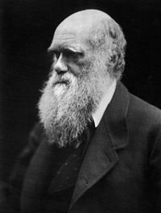
Darwin on Careers…
“It is not the strongest of the species that survives, nor the most intelligent that survives. It is the one that is the most adaptable to change.”

Slide 15
Stay in touch…
Dr Rob Hardwick
BBSRC, Polaris House
Swindon, SN2 1UH
T 01793 413243
E robert.hardwick@bbsrc.ac.uk
W www.bbsrc.ac.uk
@Rob_Hardwick_

Slide 16
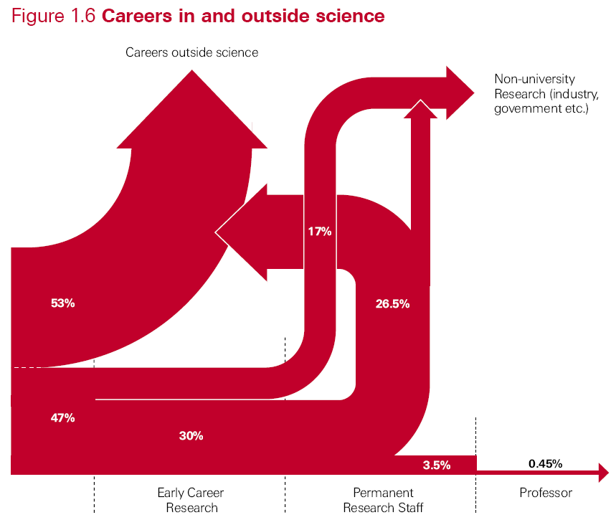
Source: The Scientific Century: securing our future prosperity (The Royal Society, 2010)
Notes:
Note this is for all scientists (not just bioscience)

Slide 17
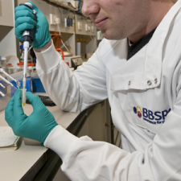
Career so far…
2012 BBSRC Strategy Development Manager
Innovation & Skills Group
Postdoctoral Researchers
Industrial training
Policy Placements
2007-2012 Postdocs
2007-09 Cardiovascular Genetics
2009-11 Genetics of immunity
(Leicester)
2011-12 Germline mutation processes (Sanger)
2007 PhD Mammalian Genetics (Leicester)
2006-07 Medici Technology Transfer (whilst writing up)
2003 MRes Molecular and Cellular Biology (Brum)
2002 BSc Biological Sciences (Brum)

