Slide 1
Part Time PIPS with Intelligent Growth Solutions

Slide 2
About Intelligent Growth Solutions (IGS)
Novel Biotech start-up with the goal of making vertical farming economically feasible, whilst also “saving the planet”
The concept itself is not a new one- many artificial farms already exist, with countries like Japan and South Korea leading the way
However, IGS has attracted a lot of attention for the way in which they are breaking many of the accepted conventions…

Slide 3
My Jobs
Market research analyst
Engineer
Physicist
Sales advisor
Scientific researcher
Botanist
And others such as lighting chef, negotiator, CO₂ monitor and the tower door fixing guy etc.
Huge variety of work, revealing the very demanding and understaffed world of start-up companies.

Slide 4
Arranging my PIPS
Really didn’t know what I could do to get the most out of three months
Finding a part time PIPS in my area of interest was difficult
Internships sent around were often not quite what I wanted
Searched around myself
Found IGS through contacts
Definitely worth searching hard and speaking to as many people as possible

Slide 5
Positives of my Part Time PIPS
I got to continue working on my PhD project
Gained a lot of valuable insight and knowledge, whilst not being fully immersed in the company
Felt much more time efficient
Both jobs provided a break from the other
Made a lot of useful contacts very easily- Speed dating of networking
Potential for a job at IGS after my PhD
Notes:
Only around for the important meetings

Slide 6
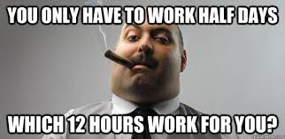
The not so good parts…
Very “enthusiastic” and tough to please boss
Initial work agreement obviously changed
Even if I was very organised it was easy to get caught out
Could be stressful at times (having to learn new things quickly)
Communication issues

Slide 7
Luck? Or a good working attitude?
Definitely both- with probably a lot more of the luck aspect
Periods where I felt forgotten
Thrown in at the deep end - sink or swim
The team at IGS are very good at what they do
Needed to be prepared to ask a lot of questions
Taking and keeping lots of good notes and records
Maintaining a positive attitude

Slide 8
Would I recommend it?
If you are willing to take a risk - absolutely
However, you need to be able to adapt and organise yourself very well
It’s a great opportunity to get the best of both worlds
You have to work hard to make it work
Be confident and don’t shy away from the big boss
Tough to compare with the full time PIPS

Slide 9
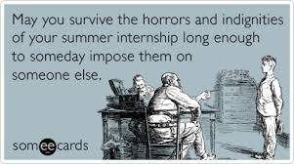
Thanks! Any questions?
And of course- Enjoy your PIPS!

