Slide 1
EAST BIO annual symposium | Harsh Vaidya
Supporting biotech innovation through grassroots approach
Harsh Vaidya
EAST BIO annual symposium, 2015
Notes:
----- Meeting Notes (15/06/15 18:17) -----
Good afternoon...thank you to organisers
asked to talk about academia-industry relationship

Slide 2
Overview
EAST BIO annual symposium | Harsh Vaidya
What is innovation?
Why is it important for biotechnology? Help patients? Environment?
Examples of areas of innovation
Who is innovating? (academia and start-ups)
Examples of pharma industry’s efforts at sourcing innovation
What is the gap in the process of innovation? In other words, what are the limiting steps of getting innovations to market? Examples: funding,
What is Innovation Forum?
What do we do to bridge the gap?
Examples of various activities
Video of ILC
Why is this important?
Who are our supporter companies?
Why should you as researchers care? To ensure that your research results in patient benefits; if you start a company in the future; contacts if you want to get a non-academic job

Slide 3
Academia-Industry relationship
EAST BIO annual symposium | Harsh Vaidya
Notes:
----- Meeting Notes (15/06/15 19:02) -----
This essentially sums up the relationship between...
Its a love-hate relationship. However, this relationship has developed alot in the last few years. While interactions with industry were frowned upon in a more conventional academic environment, we are now actively supporting industrial collaborations.
But when we think about the academia-industry relation, we need to understand the underlying driving force that governs this relation.

Slide 4
What is Innovation?
EAST BIO annual symposium | Harsh Vaidya
Simply put, innovation is the process of doing something new, different, smarter or better that will make a positive difference.
encompass Scotland
Notes:
----- Meeting Notes (15/06/15 19:02) -----
If I was to summarize this in one word, it would be innovation.
Innovation has become the buzz word of today. Every technology sector is heavily focusing on innovation. Every company wants to be innovative. Every one who is someone in technology sectors wants to become an innovator. And its not just industries, some of the universities even have departments focusing on innvoation.
However, this term that's used very extensively is often vaguely defined.
I think this definition of innovation, on encompass Scotland website, is the best definition I have come across...what it says is that...
The emphasis here is on "positive difference"...so how does innovation in biotech lead to positive difference? Or in other words, why do we need to innovate in biotech?

Slide 5
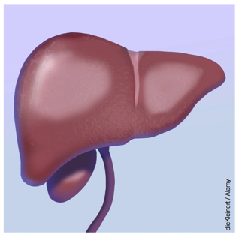
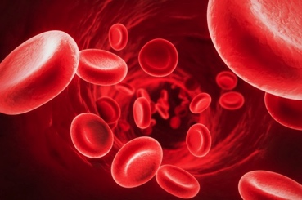
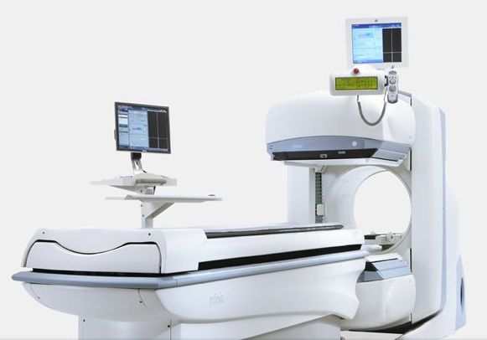
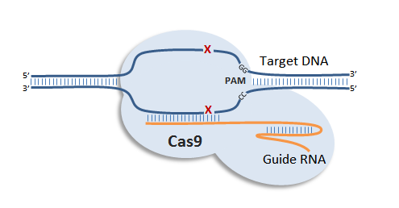
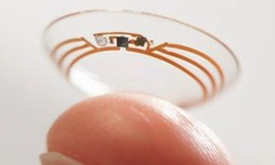
Importance of innovation in Biotech (positive difference)
EAST BIO annual symposium | Harsh Vaidya
Help patients
Find cures for diseases
Improve diagnostics
Better availability to treatment
Improve quality of life
Develop new technologies to help improve our understanding of biology
identification of viral species in blood
imaging system for diagnosis
cytokine removal
creating organs for transplant
reduce cost of drug discovery
blood glucose monitoring lens
CRISPR-Cas9 for gene editing and therapeutics
Notes:
----- Meeting Notes (15/06/15 19:02) -----
Here are some of the obvious examples why innovation is important.
Firstly, to help patients, by finding cures for diseases. Like this new technique to remove cytokines from blood to prevent or reduce cytokine storm or this possibility of creating organs for transplant.
We also need innovation to improve diagnostics. A lot of diseases are still diagnosed too late to be able to effectively intervene. But this is changing with new technologies such as this one which...
Another area which is much less discussed but requires true innovation is availability of drugs. The prices of several treatments are in the range of several hundred thousands of dollar per patient. This is obviously not sustainable. However, organisations like MyelomaUK are working on a really innovative approach to reduce drug pricing to make it more accessible to patients.
Finally, innovative technologies such as this blood glucose...
But besides helping patients, innovation is also required to help improve our research cababilities. An excellent example of this is the CRISPR-Cas system...

Slide 6
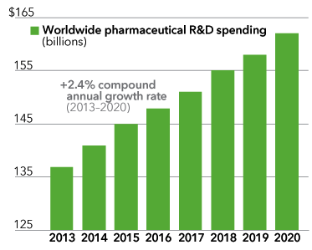
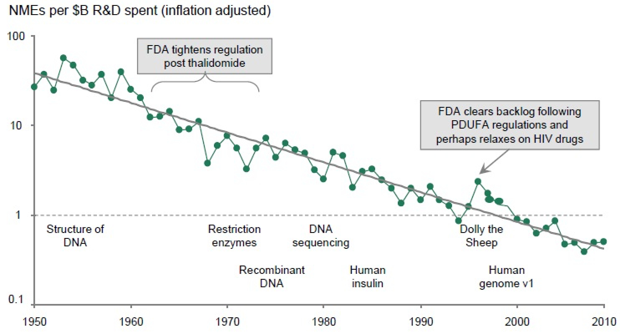
Who are the major innovators in biotech?
EAST BIO annual symposium | Harsh Vaidya
Pharmaceuticals R&D spending continues to increase while the number of New Molecular Entities (NMEs) approved per billion dollar spent in R&D is decreasing
Pammolli et al. 2011
Notes:
----- Meeting Notes (15/06/15 19:02) -----
However, this begs the question: "Who is actually innovating"? Traditional wisdom suggests that since industry has more money, they must be the ones innovating.
However, this not true, especially in pharmaceutical industry. Pharma companies have been spending increasing amounts of money on R&D, however, as we heard yesterday, the number of drugs approved has been decreasing since 1950s. So obviously they are not at the forefront of innovation.
Pharma companies these days typically look for innovation externally.

Slide 7
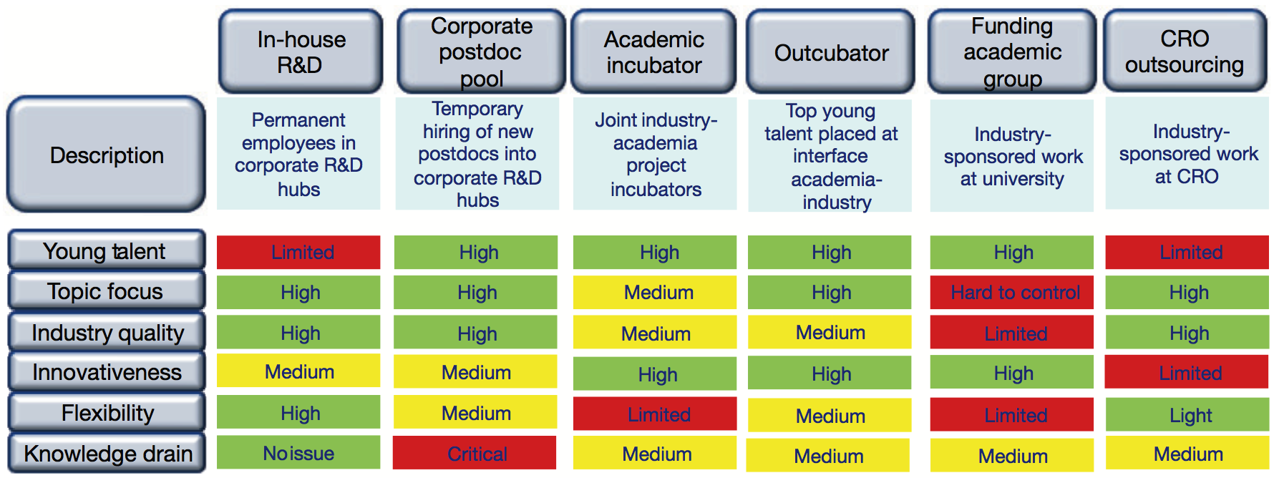
Models for sourcing innovation in pharmaceutical industry
EAST BIO annual symposium | Harsh Vaidya
Ulrich Betz and Christian Tidona
Most of these models rely on universities and/or start-ups
Notes:
----- Meeting Notes (15/06/15 19:02) -----
They have been trying various models for sourcing innovation. The table here presents a good summary of these models.
The most important thing to take away from this table is that most of these models, except the internal R&D, relies on universities or start-ups.
The reason behind this is that most of the innovation in biotech is coming from universities and start-ups. We saw an excellent example of this in Caroline's talk yesterday.
So, then it becomes obvious that industry is keen to establish good relationship with universities, because they rely on them to provide the next big thing.

Slide 8
What’s in it for universities?
Research funding is on decline globally
Many funding initiatives, such as EU consortium, require industry partners
There is an increasing focus on translational research to deliver
What’s in it for YOU?
Young Researchers
(PhD students/Post-docs)
PI positions
Notes:
----- Meeting Notes (15/06/15 19:02) -----
But what's in it for universities?
Well, there has been a decline in research funding globally, and competition for research grants are becoming extremely fierce.
There is also a push from funding bodies to work on translational science and to involve industrial partners in research. Initiatives such as CASE studentship provides a means of attracting funding
I think this is actully good for PhD students as this means that students have the opportunity to develop additional skills which they would not necessarily have developed otherwise.
The latest stats show that only 10% of PhD students will end up becoming PIs. Thus, a large proportion of the remaining 90% will move out of academia at some point.

Slide 9
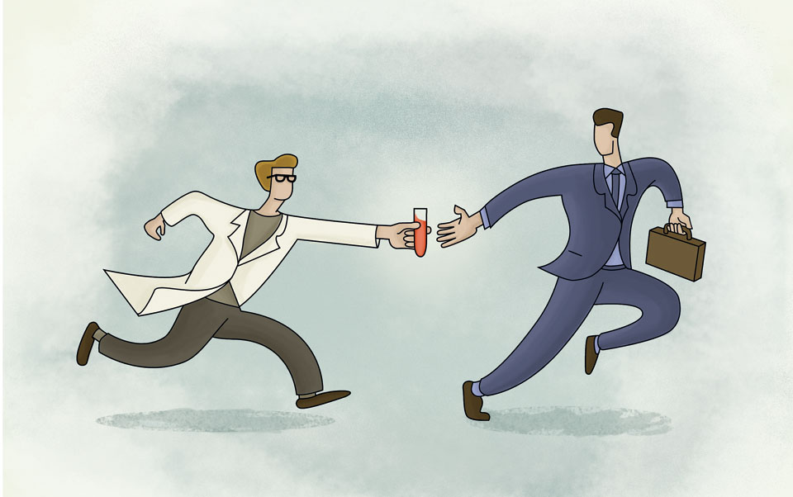
Tech transfer office: let’s commercialize research
EAST BIO annual symposium | Harsh Vaidya

Slide 10
Hurdles to innovation
EAST BIO annual symposium | Harsh Vaidya
Most of university research is never commercialized: 70% of University research does not reach or pass Tech Transfer desk (too early, under-capacity, no incentive)
Start-ups face many challenges – funding, growth, talent recruitment
Academics are not trained to think about commercial potential of their research
Limited resources on the part of industry and universities (at least in terms of finding collaborative opportunities)
Notes:
----- Meeting Notes (15/06/15 23:07) -----
most uni research is never commercialised...meaning that lots of innovation end up not benefiting anyone
start-ups face a number of challenges...like we heard yesterday, start-ups, particularly therapeutics, need a large amount of money...international recognition and growth, and talent recruitment

Slide 11
EAST BIO annual symposium | Harsh Vaidya
Why is relationship with industry important for universities?
-- decrease in research funding
-- increased emphasis by funding bodies on translational research (impact)
-- source of revenue

Slide 12
VISION
EAST BIO annual symposium | Harsh Vaidya
TO UNLEASH THE TRANSFORMATIVE POTENTIAL OF SCIENTIFIC ENTREPRENEURSHIP
Notes:
The innovation forum was set up in 2012 with the vision to unleash the transf....
Across the world we are seeing several important trends.
First an unprecedentet rate of unemployment umong young people
This is one of the factors why more people choose to study and for longer. Many of them up to the PhD level. That creates a group of highly educated highly capable people who however also cannot fing EMPLOYMENT matching their SKILLS and POTENTIAL.
We belive that in the current state of technology it is possible to unleash the potential of scientific entrepreneurship for the benefit of young researchers, the economy and the society at large.

Slide 13
mISSION
EAST BIO annual symposium | Harsh Vaidya
ACCUMULATOR, ACCELERATOR AND BROKER OF IDEAS AND EXPERTISE: CONNECT ENTREPRENEURIAL SCIENTISTS WITH INDUSTRY EXECUTIVES, INVESTORS AND POLICY MAKERS
Notes:
The mission of IF is to

Slide 14
An accelerator for high-tech start-up
EAST BIO annual symposium | Harsh Vaidya
What do we do?
Skills Development
Innovation Leader Conference (ILC15)
Workshops (e.g. IP)
Seminars
Facilitating
Investments
IF Business Idea Competition
IF Investor Day
Moving Ideas Forward
Innovation Leader Conference (ILC15)
IF Business Idea Competition
Networking
Notes:
What we actually do?
We provide informal learning opportunities for BOTH startups and more mature ventures through: workshops/ seminars and hands on projects , Advice lounge during ILC
And we provide opportunities for those who seek investments and those who want to invest.
All this to move Ideas foward.

Slide 15
An accelerator for high-tech start-up
EAST BIO annual symposium | Harsh Vaidya
What do we do?
Skills Development
Innovation Leader Conference (ILC15)
Workshops (e.g. IP)
Seminars
Facilitating
Investments
IF Business Idea Competition
IF Investor Day
Moving Ideas Forward
Innovation Leader Conference (ILC15)
IF Business Idea Competition
Networking
Notes:
What we actually do?
We provide informal learning opportunities for BOTH startups and more mature ventures through: workshops/ seminars and hands on projects , Advice lounge during ILC
And we provide opportunities for those who seek investments and those who want to invest.
All this to move Ideas foward.

Slide 16
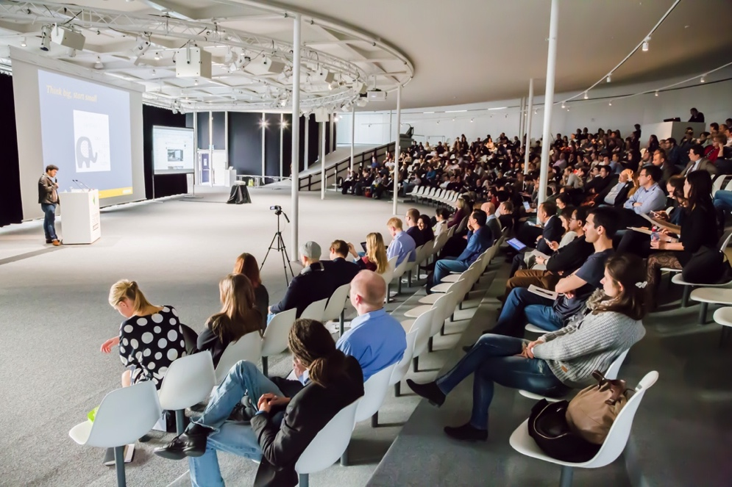
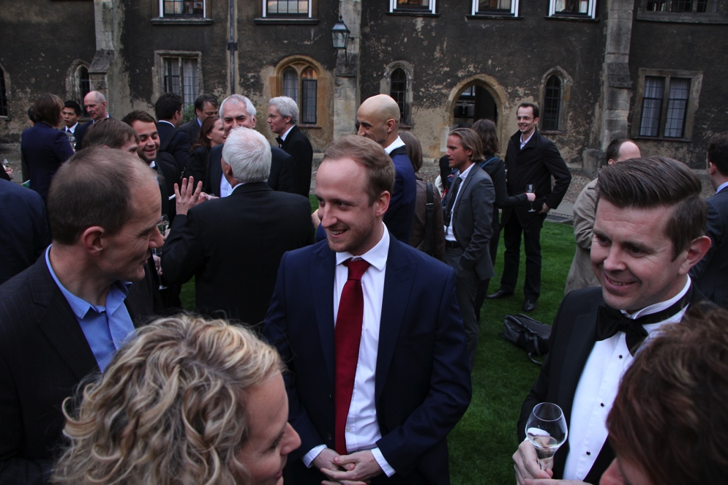
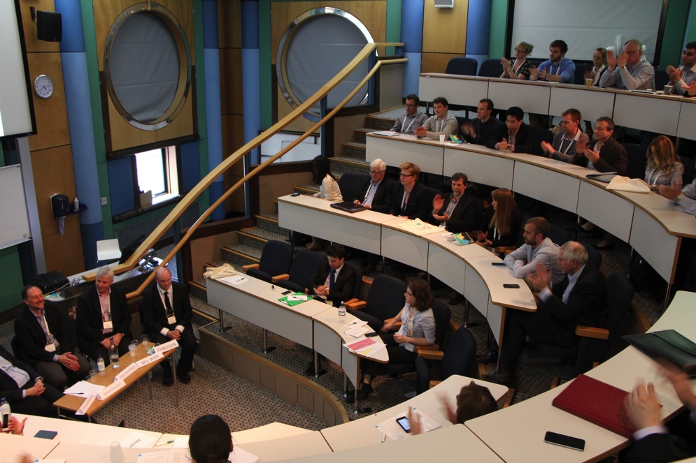
EAST BIO annual symposium | Harsh Vaidya
Networking: key to innovative collaborations
Training for young researchers: learn from industry leaders
Opportunity to talk about your research to industry
Job opportunities
For start-ups
Opportunity to engage with pharma, investors, and other start-ups
Notes:
What we actually do?
We provide informal learning opportunities for BOTH startups and more mature ventures through: workshops/ seminars and hands on projects , Advice lounge during ILC
And we provide opportunities for those who seek investments and those who want to invest.
All this to move Ideas foward.

Slide 17
An accelerator for high-tech start-up
EAST BIO annual symposium | Harsh Vaidya
What do we do?
Skills Development
Innovation Leader Conference (ILC15)
Workshops (e.g. IP)
Seminars
Facilitating
Investments
IF Business Idea Competition
IF Investor Day
Moving Ideas Forward
Innovation Leader Conference (ILC15)
IF Business Idea Competition
Networking
Help start-ups secure investment!
Help business ideas get off the ground!
Notes:
What we actually do?
We provide informal learning opportunities for BOTH startups and more mature ventures through: workshops/ seminars and hands on projects , Advice lounge during ILC
And we provide opportunities for those who seek investments and those who want to invest.
All this to move Ideas foward.

Slide 18
EAST BIO annual symposium | Harsh Vaidya
UK BRANCHES
Notes:
Scottish team -

Slide 19
EAST BIO annual symposium | Harsh Vaidya
GLOBAL BRANCHES
14 branches globally
Reaching 100,000 innovators and growing (our sponsors can tap in to this global network)
Copenhagen
UK
Copenhagen
Munich
New York
Lausanne
Tokyo
Barcelona
Tokyo
Barcelona
Hong Kong
Hong Kong
Notes:
Check the numbers

Slide 20
EAST BIO annual symposium | Harsh Vaidya
Innovation Forum spin-outs
> £5M in investment and revenues
Notes:
Cumulatively the companies have already raised or in funding or revenues more than 5 million pounds

Slide 21
Our Sponsors and Partners
EAST BIO annual symposium | Harsh Vaidya
Notes:
Add here partners/sponsors logo

Slide 22
Future of Innovation…where are we heading?
Notes:
We live in an increasingly collaborative world

Slide 23
More academia-industry partnership
EAST BIO annual symposium | Harsh Vaidya
Future of Innovation…where are we heading?

Slide 24
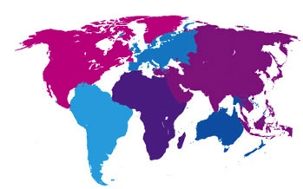
EAST BIO annual symposium | Harsh Vaidya
Future of Innovation…where are we heading?
More collaborations across generations
Current international young researchers and young professionals are very similar minded and easily collaborate to accelerate international innovation development.
Notes:
The so called generation Y or the millenials (todays 20 – 30 something yr) gew up in the era of internet, instante messaging and acess to information.
I would say that the mind set of a millenial is in many ways similar to the mindset of an entreprenur – quick turnover, dealing with a lot of information CREATIVIT and LACK OF FIXED structure
These are challenges but also opportunities

Slide 25
organic chemistry
analytical chemistry
physical chemistry
thermodynamics
cell biology
biochemistry
fluid mechanics
genetics
quantum physics
zoology
astrophysics
psychology
BIOLOGY
CHEMISTRY
PHYSICS
More interdisciplinary collaborations
Notes:
Polymath – popularised as ‘The Last Man Who Knew Everything’… Thomas Young: contributions to Egyptology, music, optics, physiology (studied around the corner at Emmanuel).
Individual multidisciplinarians (at a time when deep understanding of different fields was possible) – were innovative powerhouses. Priestley, Benjamin Franklin, Darwin, Snow
This century has yielded many great minds – but none whose contributions have the breadth…

Slide 26
EAST BIO annual symposium | Harsh Vaidya
engineers
biologists
computer scientists
clinicians
chemists
mathematicians
physicists
Grassroots researchers need to be involved in parallel to strong leadership from the senior levels
social scientists
business schools
incubators
hospitals
university administrators
venture capital
civil servants
entrepreneurs
politicians
start-ups
corporates
angel investors
science parks
professional services
Notes:
In order for innovation to happen increasingly specialised experts need to learn how to collaborate

Slide 27
EAST BIO annual symposium | Harsh Vaidya
STAY IN TOUCH!
www.inno-forum.org

Slide 28
FUTURE OF INNOVATION
EAST BIO annual symposium | Harsh Vaidya
Requires:
Grassroots researchers to be involved in parallel to strong leadership from the senior levels
Cross-interdisciplinary is key
Open access and collaborative efforts between
industry–academia and industry–startups is key
International collaborative efforts
Universities facilitating low entry barrier for early stage researchers to commercialise (skills and awareness development)

Slide 29
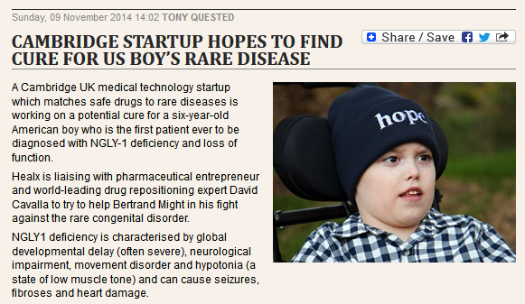
Open access
EAST BIO annual symposium | Harsh Vaidya
Open access scientific and drug databases allow for drugs to be enhanced or repositioned

Slide 30
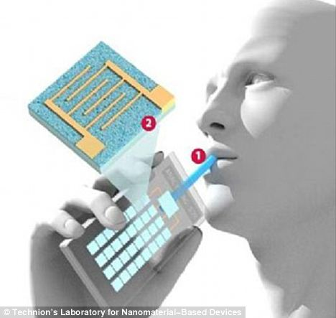
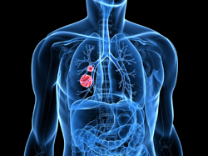
INTERACTION
EAST BIO annual symposium | Harsh Vaidya
ACROSS DISCIPLINES
DRIVES INNOVATION
“
All decisive events in the history of scientific thought can be described in terms of mental cross-fertilization between different disciplines.
”
- Arthur Koestler
2 engineering and 2 biomedical PhD students develop:
Breath-analyser for early stage lung cancer
Notes:
Such collaboration are happening and are yielding extraordinary results

Slide 31
Across generations: Grassroots and Senior Executive Alignment
EAST BIO annual symposium | Harsh Vaidya
Notes:
If we can align the multigen teams along clear objectives they can deliver much more by stepping out of the usual corporate box

