Slide 1
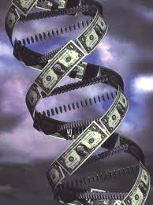
Giving birth to a biotech........where’s the pain relief ?!
Dr Caroline Barelle MBA

Slide 2
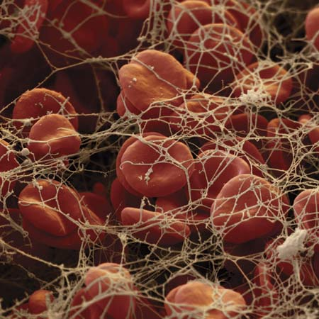

Fibrinolysis - PhD
BSc Biochem
University

Slide 3

Medical mycology
Academia
University

Slide 4
PI
Academia
University

Slide 5
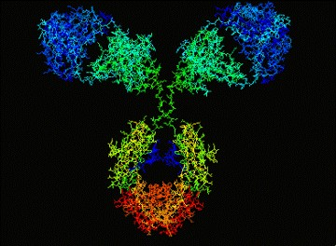

Biotech
Academia
University

Slide 6
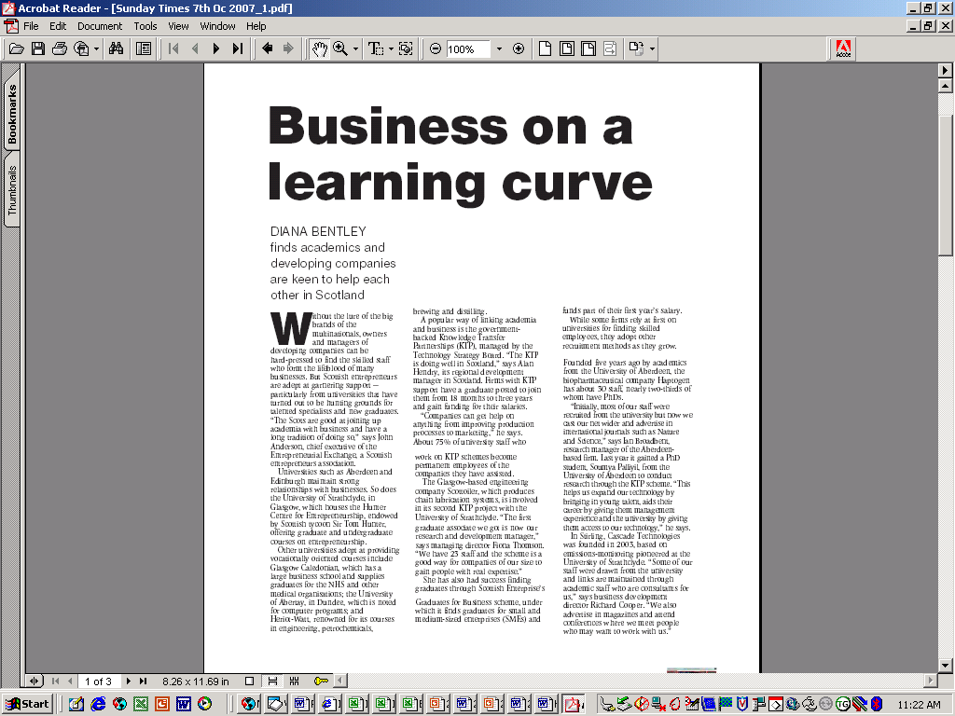

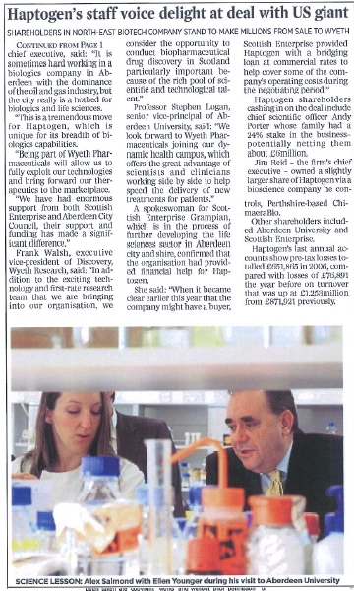
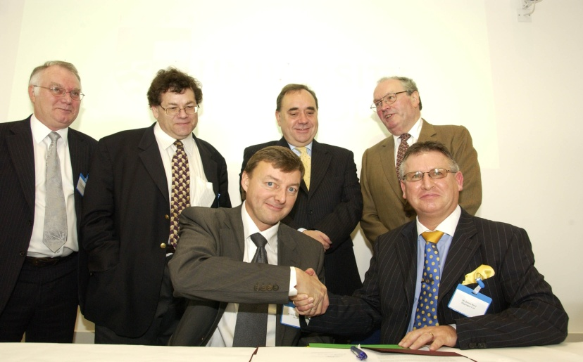
Stop Press………October 2007 Wyeth acquires Haptogen

Slide 7
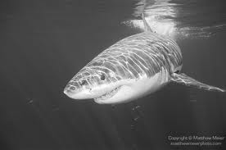
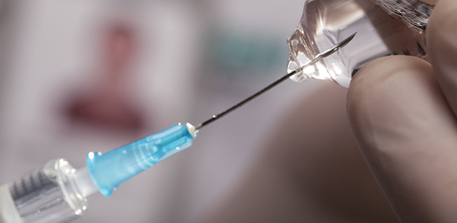

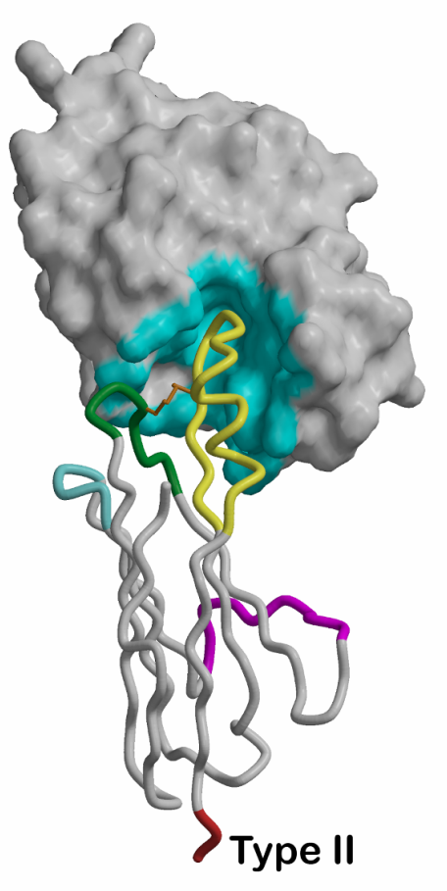
From the ocean to the clinic……………..

Slide 8
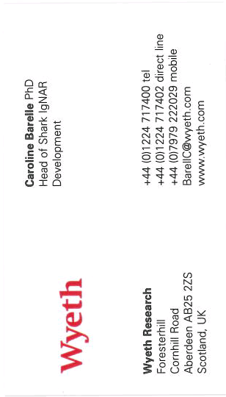

Pharma
Biotech
Academia
University

Slide 9
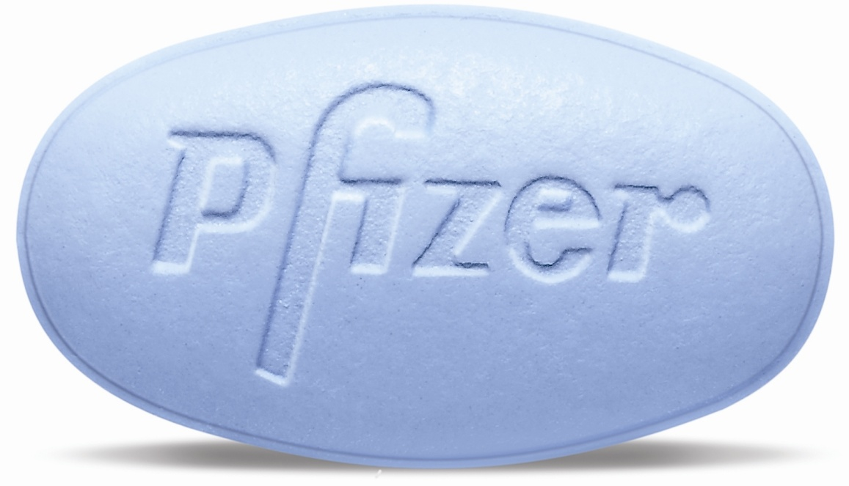
A shot from the blue………………..

Slide 10
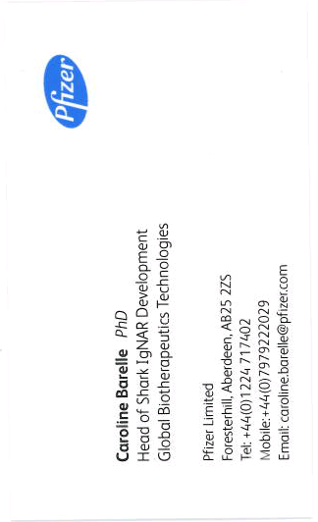

The biggest Pharma
Pharma
Biotech
Academia
University

Slide 11
The biggest Pharma
?
Pharma
Biotech
Academia
University

Slide 12
The biggest Pharma
Asset portfolio
IP/domains
Pharma
Biotech
Academia
University

Slide 13

The biggest Pharma
Investment
Pharma
Biotech
Academia
University

Slide 14
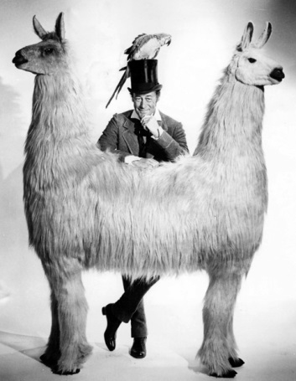
Pushmi-Pullyu/Need-Desire………………

Slide 15
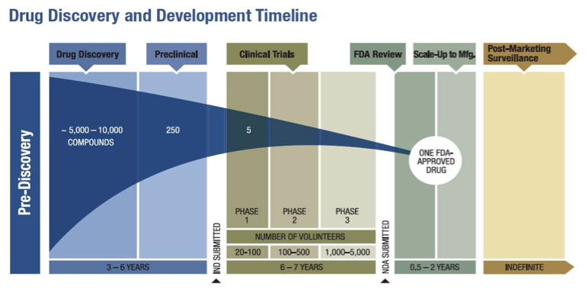
The Business of Biotech………………
Takes a long time and a lot of money

Slide 16
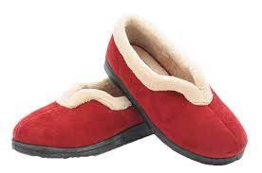

The Model………………
Medical devices,
Clinical Diagnostics,
  Lower risk, lower return
  Potential for early revenues
  Exit often trade-sale
Drug discovery
  High risk
  Makes nothing, sells nothing
  99% chance of failure
  Consumes loads of cash
  Returns are staggering if successful

Slide 17

The Model………………
Medical devices,
Clinical Diagnostics,
  Lower risk, lower return
  Potential for early revenues
  Exit often trade-sale
Drug discovery
  High risk
  Makes nothing, sells nothing
  99% chance of failure
  Consumes loads of cash
  Returns are staggering if successful

Slide 18



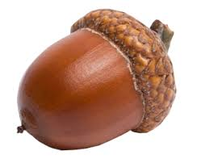
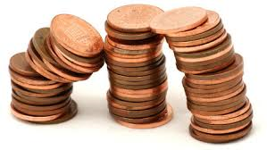
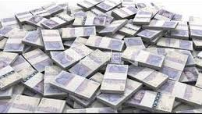
Money, money, money………………..
Seed
Series A
Series B
Series C

Slide 19
The Process………………
Idea generation and validation
IP from University/parent body
Technology validation – “Proof of Concept”
Early Stage – Start up
Technology platform and IP broadening
Late stage – Expansion/public offering
Continue with clinical development (Launching of product) and prepare exit (Eg., IPO)
Aim for cash flow, break – even and lastly profit
Commercial prototype and early pre – clinical trials.
Management team & Scientific group hiring
Partnership and building company infrastructure

Slide 20
The Conception………………..
Asset portfolio
Pre-commercialisation cash
Build team and company value
Proposals

Slide 21

The Development………………..
Reporting
Milestones
Conferences
Collaborations
CROs
Meetings
Science
Value build
Investor ready
Value proposition
Commercial
Investors
Customers
BP
Consultants
IP
Secure seed/series A

Slide 22
The Labour………………..
Lead the Science
Operations
Business Development
Commercialisation/Corporate
Alliance management
Reports
Due Diligence
IP
Papers
Conferences
BioPartnering
Budget

Slide 23
The Birth………………..
Articles of association
Shareholding
Legal
Employee contracts
Facilities
Finance
IP
Consultants
SAB
Chair
Directors
NEDs
Marketing
Website
HR
Organizational Development
Press
The next tranche of cash!

Slide 24

The Pain Relief………………..
A good team
External support
Be realistic
Enjoy

Slide 25
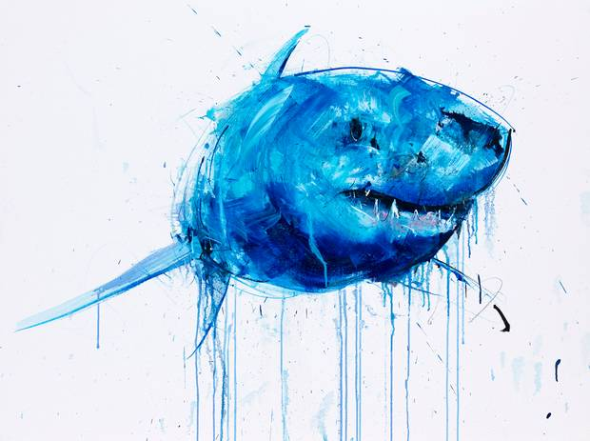
Questions??

